Slide 1
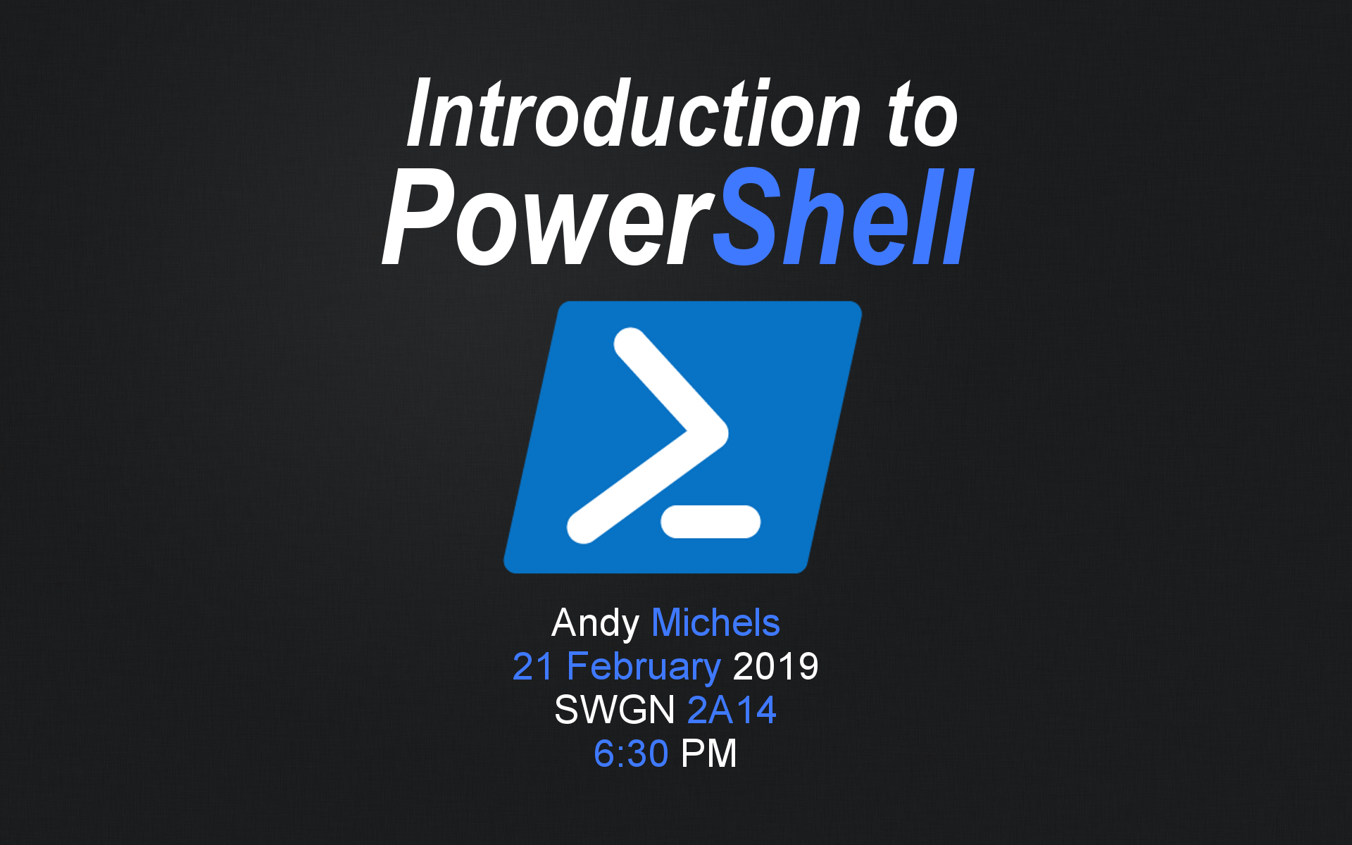
Notes:
Go over disclaimers. HUGE NOOB AT THIS STUFF. I’m here to learn as well. Please don’t hate me if I get something wrong or if I don’t know something.

Slide 2

Overview
What is PowerShell?
Cybersecurity Examples
Data Storage
Port Scanning
Under the Wire
Where to Learn More
Notes:
Really, this is just for you guys to get a basic idea of what PowerShell can do and how it applies to cybersecurity. I’m assuming a little bit of programming and system administration knowledge, but please feel free to ask me to clarify. All I’m going to do is introduce PowerShell and what kind of things it can do. I’ll then introduce how you can leverage the scripting language for system administration, incident response, and blue / red teaming. We’ll just be going over some code examples and I’ll explain what they do. To finish, we’ll go over a bit of what UnderTheWire is and where you can learn more about this stuff.

Slide 3


What is PowerShell?
Introduced in 2006
Scripting language (basically a simplified C#)
Can embedded in a GUI or be used as a CLI
Built on the .NET Framework
Access to Windows API
“It’s already at the party; just show up and start leveraging it”
Notes:
QUICK FACTS!!!!!!!!!!!! Installed by default as part of the operating system
It can pretty much access and manage most of the components within the operating system, so like the registry, regular files, WMI (Windows Management Instrumentation, which is used to manage devices and applications), and change settings

Slide 4

Benefits for Black Hats / Penetration Testers
Antivirus struggles picking it up
Code injection
Doesn’t touch disk (mostly)
Leaves almost no forensics evidence
Remote shells
Notes:
(although admittedly, AV is getting much better)
you can inject code with this and it won’t touch the disk (most) of the time.
This means you’re gonna be leaving barely any forensics evidence of what you did on a system
It also can open up a shell / command line remotely (remote shells) on targets.

Slide 5









...please don’t use PowerShell for those purposes.
Notes:
Just for educational purposes. PowerShell can be very powerful, but also extremely destructive. REMEMBER. PERMISSION.

Slide 6

How Does It Work?
Cmdlets (“command-lets”), scripts, functions, and output
Cmdlets are just .NET classes doing certain things
Can access the file system and the registry in Windows
Other people can develop cmdlets and use them in PowerShell (Control Your Tesla!)
Scripting - supports variables, functions, branching statements, loops, etc.
Output is very similar to running Linux commands

Slide 7
Examples

Slide 8



Data Storage
Mainly an offensively-focused example
Data -> Bytes -> Base64 -> Storage
Can store data fileless in...
Registry
Active Directory
And more (like Event Logs)
It’ll be there whenever we need it; who’s going to find this?
There’s no system administrator who knows every registry key
Notes:
We’re gonna store something that is going to be used later in a registry key as well as Active Directory. You can pretty much put this stuff anywhere and let it run (have it be in base 64 or something else; but seriously, who’s going to expect base 64?)

Slide 9
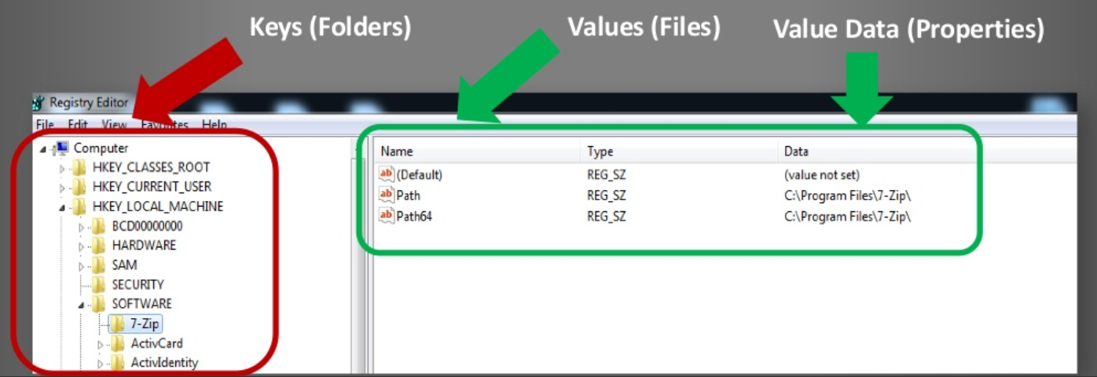
Data Storage: Registry
Registry Edit (Regedit) allows the registry to be viewed like a file system (can ls to it as well). We’re going to hide something in here.

Slide 10
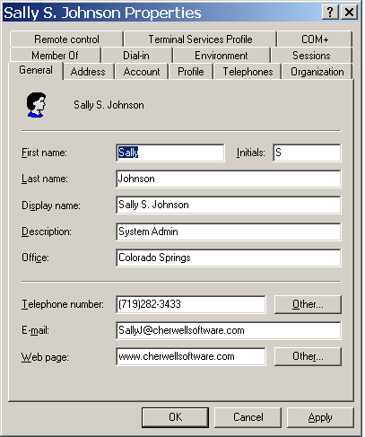
Data Storage: Active Directory
50+ properties, but size limits
Need correct permissions to change
Readable by the domain users

Slide 11
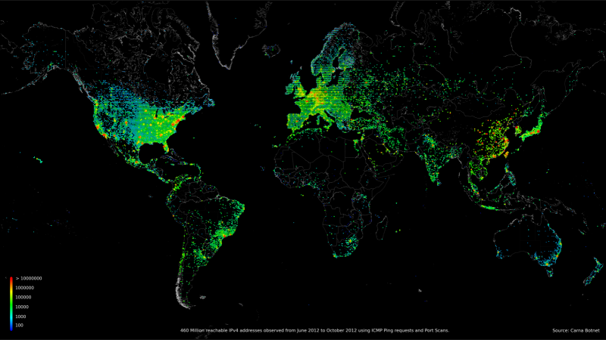

Port Scanning
Get-NetConnection
Works on v5 and above
Full connect scan and auto closes ports
Auto pings your targets
Net.Sockets.Client
Works on v2 and above (requires .NET 3.5+ as well)
Full connect scan without auto closing ports

Slide 12
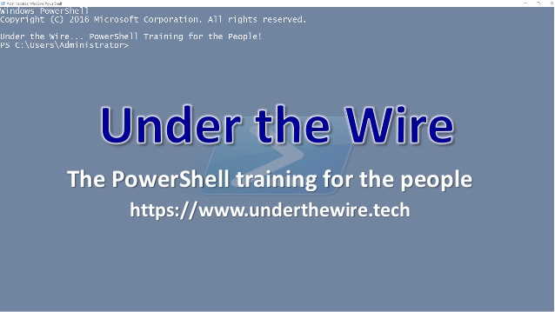
Under the Wire
Similar to Over the Wire (Linux commands)
Interactive learning
Simulates real interactions with PowerShell
Self-teaching (VALUABLE)
See also: PoSh Hunter

Slide 13





Conclusion
ABC (Always Be Coding)
Get in the reps in every day
ISE -> Get-Command -> Get-Help -> <tab>
Seriously, the tab completion in the ISE is fantastic
PowerShell is definitely on the rise
Great skill to add to your resume

Slide 14
References
Adapted from: BSides Charleston 2018 PowerShell Workshop “Powering up on PowerShell” by Fernando Tomlinson (@Wired_Pulse)
Under the Wire (http://underthewire.tech/)
PoSH Hunter

